Slide 1
Add to Teams Demo Script
Expertise in Microsoft's Azure, Office 365, and SharePoint platforms

Slide 2
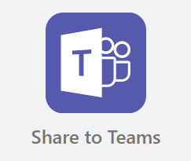
Agenda
Admin Consent
Teacher adds announcement/assignment
Student adds announcement

Slide 3
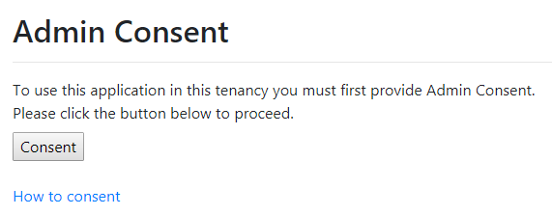
Admin Consent
Open site consent page: https://<your site URL>/consent.html
Click the Consent button.
Login with domain admin account.
Click Accept button and finish consent.
Notes:
A service application is registered in Azure Active Directory in the context of a tenant. Before a trusted application can be used in that tenant or any other tenant, tenant consent is needed. For service applications developed for a single or multi-tenant scenario, service application permission requests must be consented to by the tenant's admin.

Slide 4
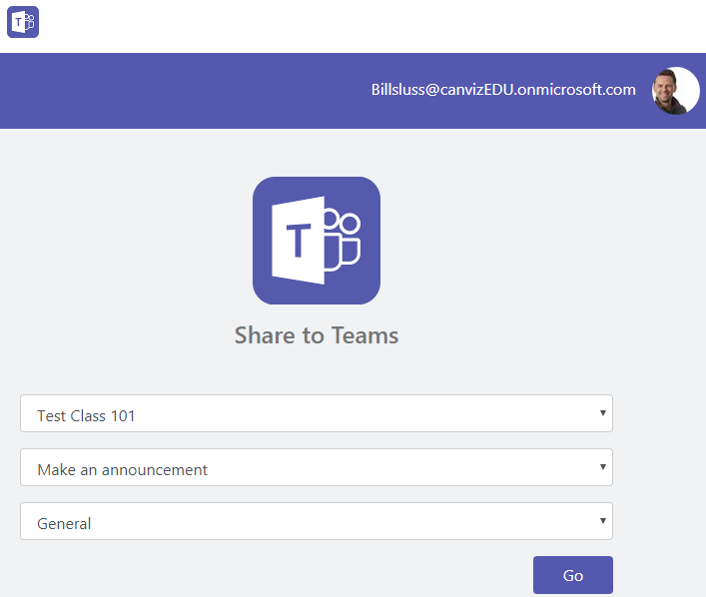
Teacher Adds Announcement
Open the site with a browser.
Click the “Add to Teams” icon on default page.
A popup window will show and then redirect user to login page.
Login with a teacher account.
Select a class/group.
Select Make an announcement.
Select a channel.
Click Go button.

Slide 5
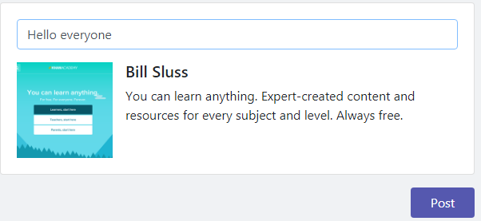
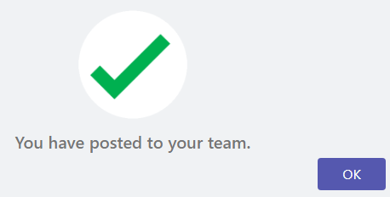
Teacher Adds Announcement
Input announce and then click Post button.

Slide 6
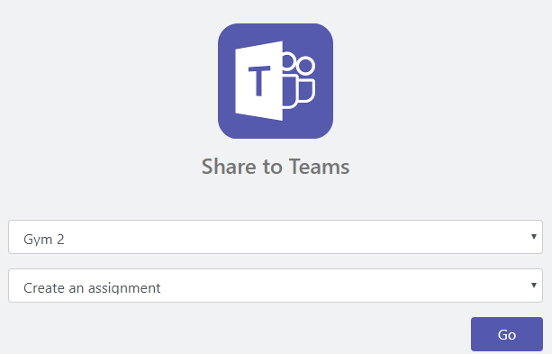
Teacher Adds Assignment
Open the site with a browser.
Click the “Add to Teams” icon on default page.
A popup window will show and then redirect user to login page.
Login with a teacher account.
Select a class.
Select Create an assignment.
Click Go button.

Slide 7
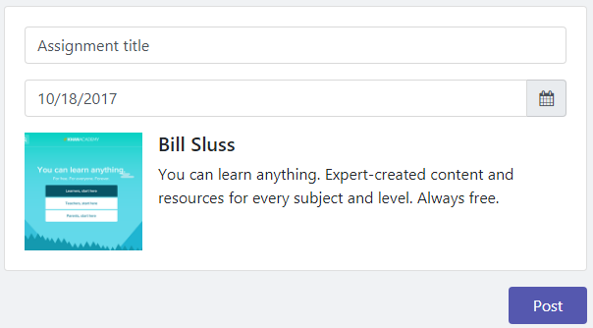
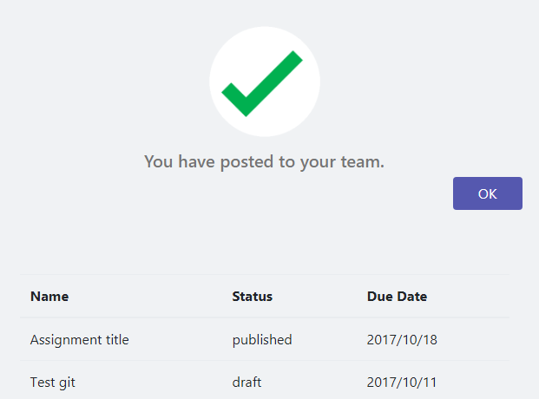
Teacher Adds Assignment
Input assignment name
Select a due date.
Click Post button.
After succeed it will show a list of all assignments in this class.

Slide 8
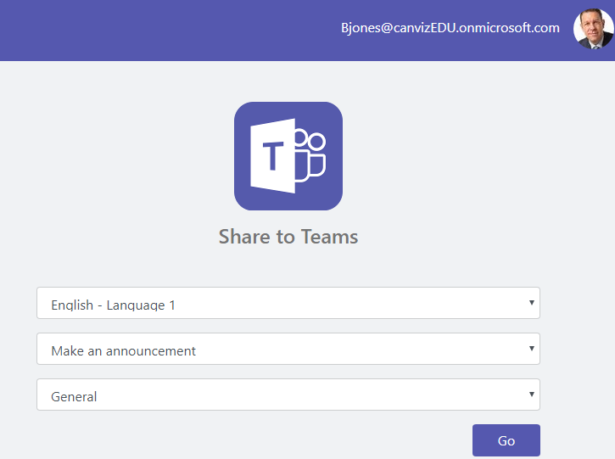
Student Adds Announcement
Open the site with a browser.
Click the “Add to Teams” icon on default page.
A popup window will show and then redirect user to login page.
Login with a student account.
Select a class/group.
Select Make an announcement.
Select a channel.
Click Go button.

Slide 9
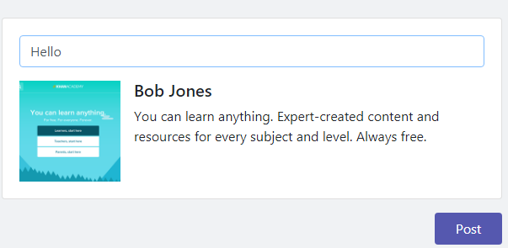
Student Adds Announcement
Input announce and then click Post button.

